Slide 1
Unit 3
Relational Algebra and Relational Calculus

Slide 2
Syllabus(Topic to be covered)
Introduction to Relational Algebra
Unary Relational Operations: SELECT and PROJECT
Relational Algebra operations from set theory
Binary Relational operations: JOIN and DIVISION
Additional Relational operations
Tuple Relational Calculus
Domain Relational Calculus

Slide 3
Introduction to Relational Algebra
Relational algebra is a procedural query language, which takes instances of relations as input and yields instances of relations as output.
It uses operators to perform queries.
An operator can either be unary or binary.
Relational algebra is performed recursively on a relation and intermediate results are also considered relations.

Slide 4
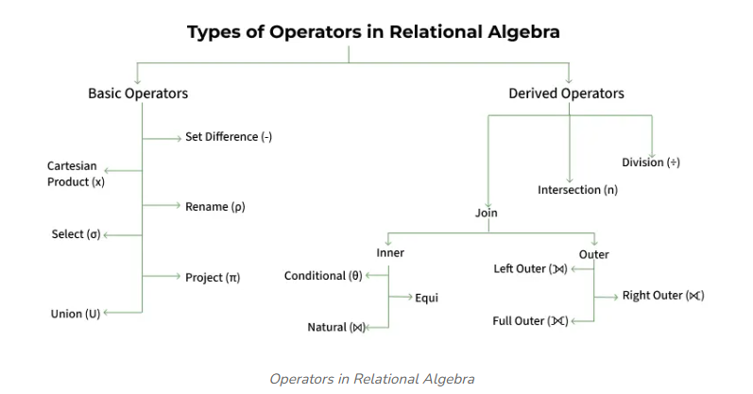

Slide 5
Unary Relational Operations
The relational algebra operations that are uses single relation(table) are called unary relational operations.
SELECT(σ)
It is used for selecting a subset of the tuples according to a given selection condition.
It is denoted by Sigma σ symbol
Select operation selects tuples that satisfy a given condition.
Syntax: σ_{<selection condition>}(R) where name stands for relation(table)

Slide 6
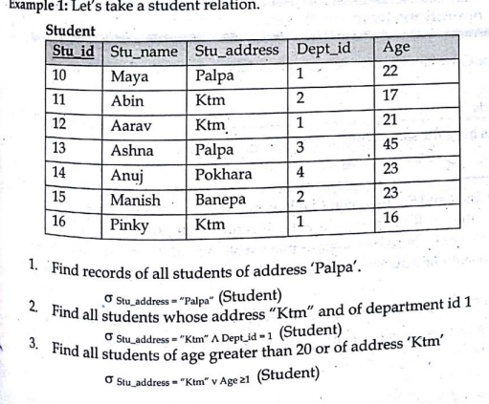
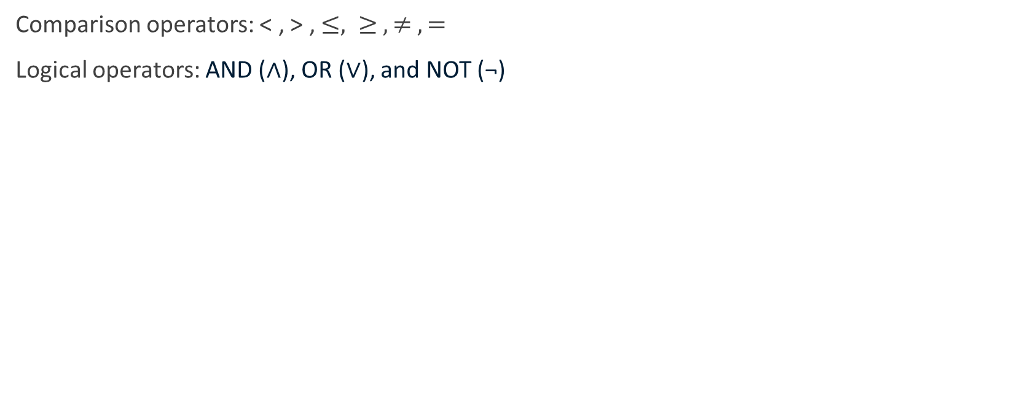
1. SELECT Operation
Comparison operators: < , > , $≤, ≥ , ≠ ,=$
Logical operators: AND (∧), OR (∨), and NOT (¬)

Slide 7
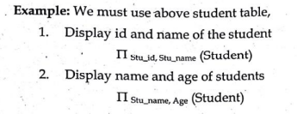
2. PROJECT Operator
Project operator is used to select certain column form the table and discards the other columns.
If we are interested in only certain attributes of a relation, we use the project operation to project t relation over these attributes only.
Syntax: ∏_{<attribute-list>}(R) where name stands for relation(table)

Slide 8
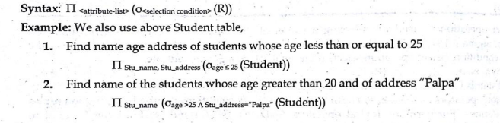
Combining SELECT and PROJECT operations
These operators can be combined
First inner operation(select operation) extract given specified rows and the then outer operation (project operation) extract only specified columns from selected rows.

Slide 9
Relational algebra operations from set theory
These operations except Cartesian product set operation take two input relations and must be union compatible:
Tuples must have same no. of fields
Corresponding fields have the same data type
Set operations are:
Union
Intersection
Difference
Cartesian Product

Slide 10
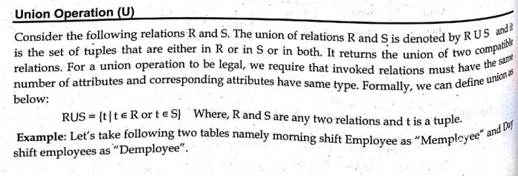
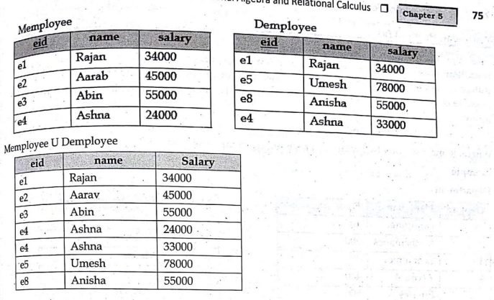

Union Operation($∪$)

Slide 11
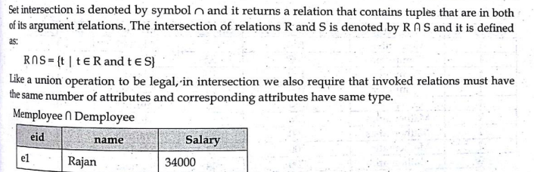

Intersection Operation($∩$)

Slide 12
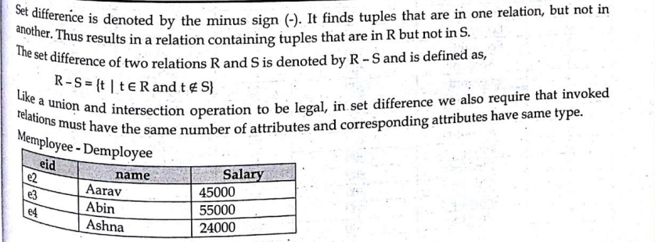

Difference Operation($−$)

Slide 13
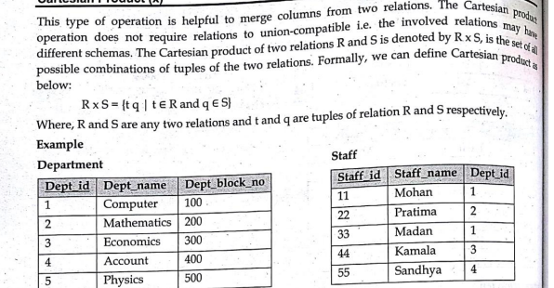
Cartesian Product(x)

Slide 14
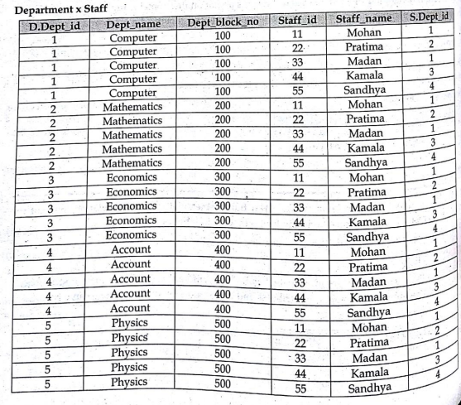
Cartesian Product(x)

Slide 15
Binary Relational Operations
These operations are used to perform operations into multiple tables. Set relational algebra operations are also called binary relational operations but here explain join operation and division operations as binary relational operations
JOIN operation
Division operation

Slide 16
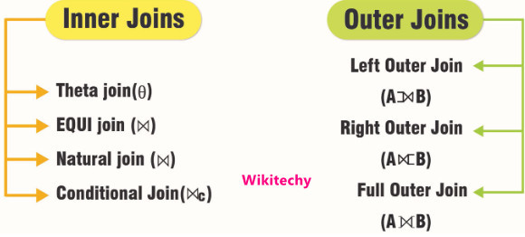
1. JOIN operation
Join operation is defined as merging or combining the related tuples from the two different relations into a single type.
It allows you to retrieve meaningful data by combining rows that satisfy certain conditions across two or more tables.
It can be said that it is similar to cartesian product expect the fact that in cartesian product, we get all the possible combinations of relations while in join, only those combinations can be formed that meets some matching conditions.

Slide 17
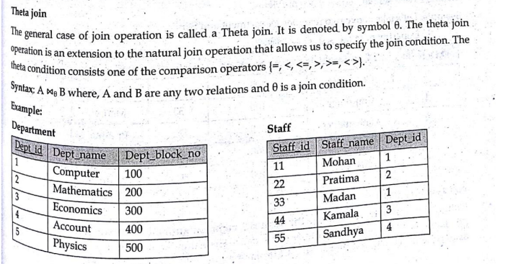
1.a.Inner JOIN
In an inner join, only those tuples that satisfy the matching criteria are included, while the rest are excluded.
Theta join

Slide 18
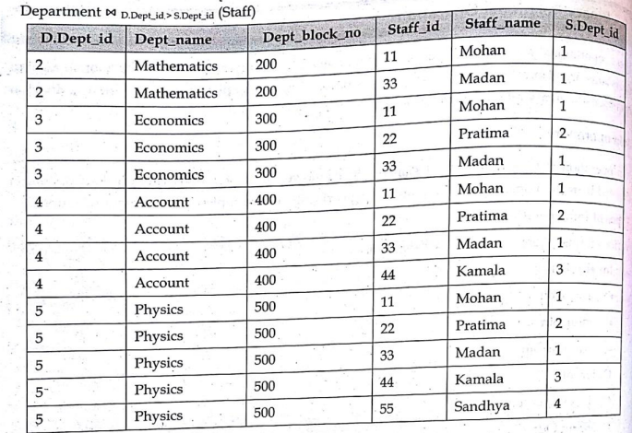
1.a.Inner JOIN

Slide 19
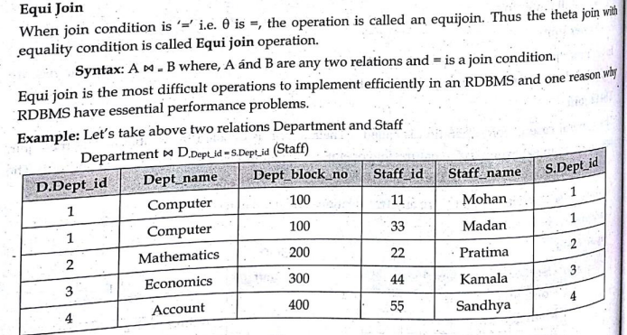
1.a.Inner JOIN

Slide 20
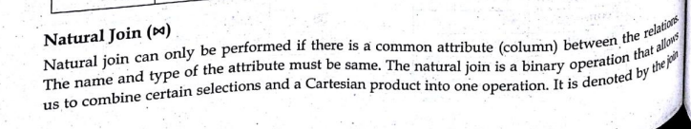
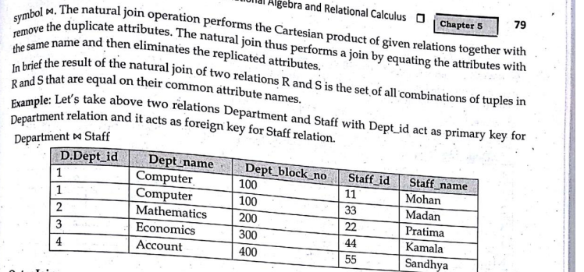
1.a.Inner JOIN

Slide 21
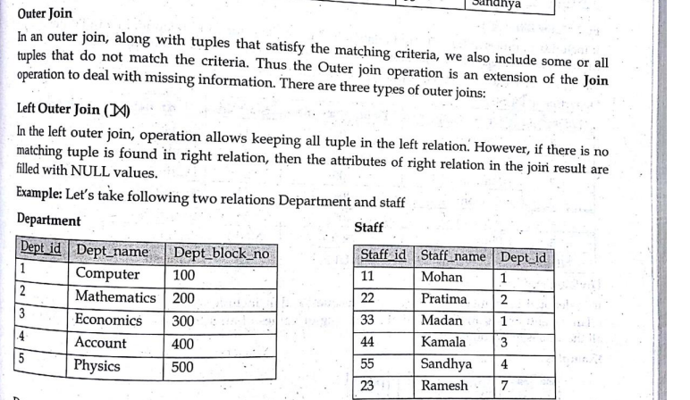
1.b.Outer JOIN

Slide 22
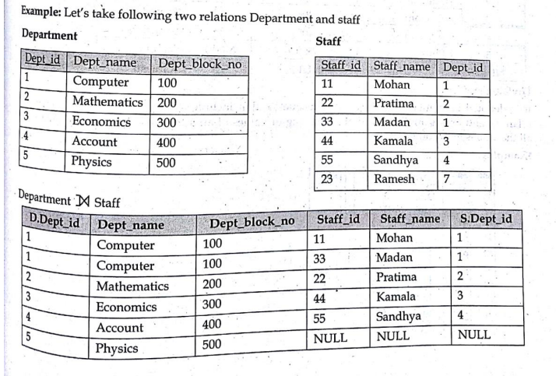
1.b.Outer JOIN

Slide 23
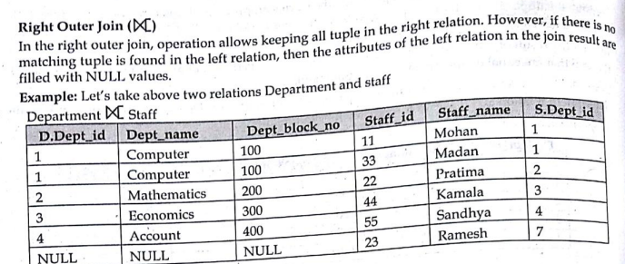
1.b.Outer JOIN

Slide 24
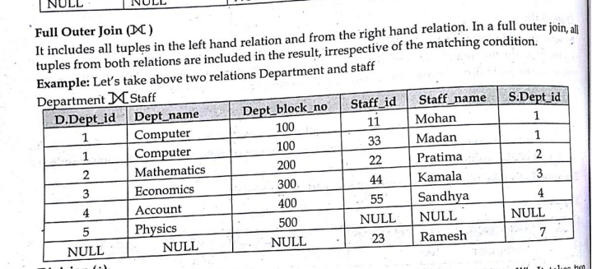
1.b.Outer JOIN

Slide 25
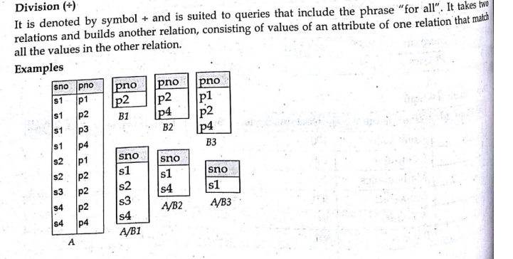
2. DIVISION operation
The DIVISION operation in relational algebra is used when you want to find a set of tuples in one relation that match all tuples in another relation.
It is useful in queries that involve “all” conditions, such as “find the entities that relate to all items in a set.”

Slide 26
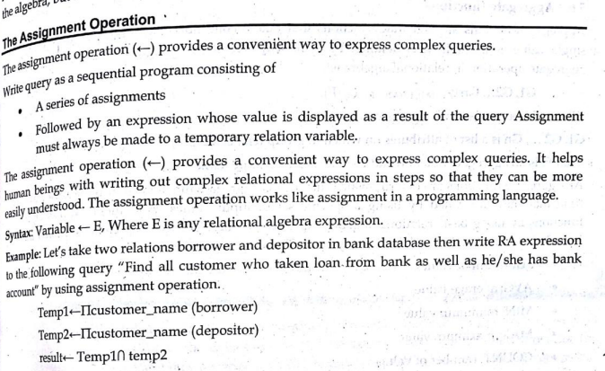
Additional Relational Operator

Slide 27
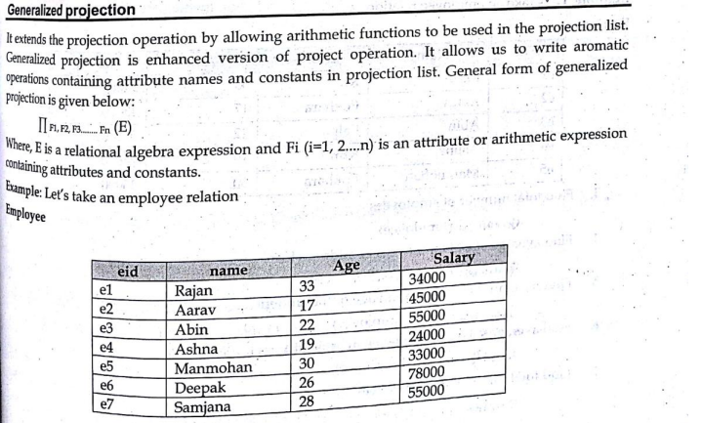
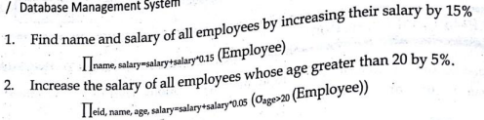
Additional Relational Operator

Slide 28
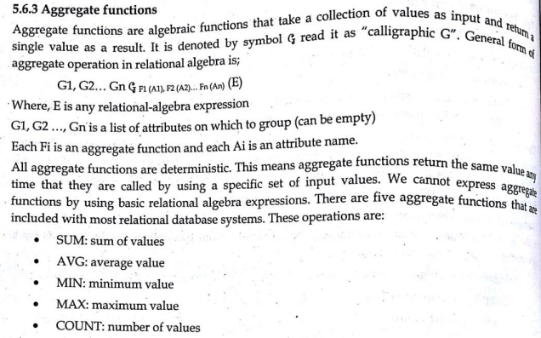
Additional Relational Operator

Slide 29
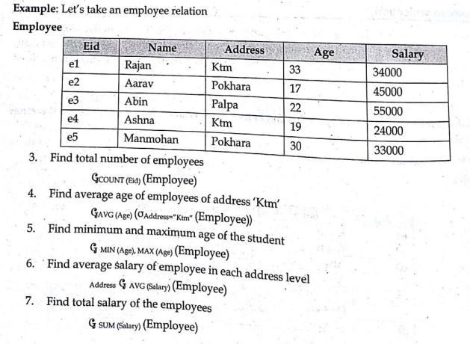
Additional Relational Operator

Slide 30
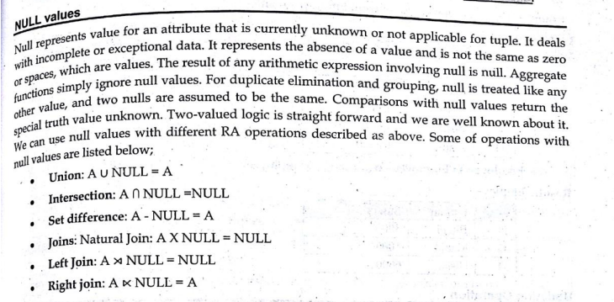
NULL Operator

Slide 31
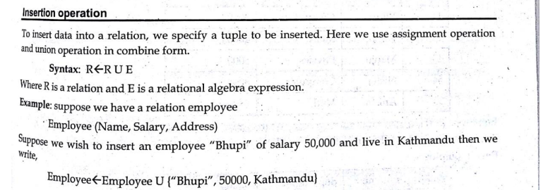
Database manipulation

Slide 32
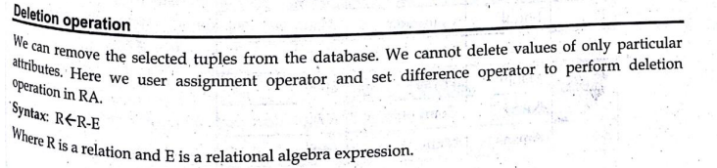
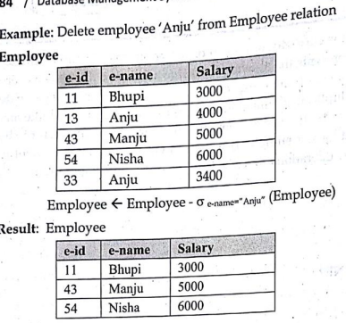
Database manipulation

Slide 33
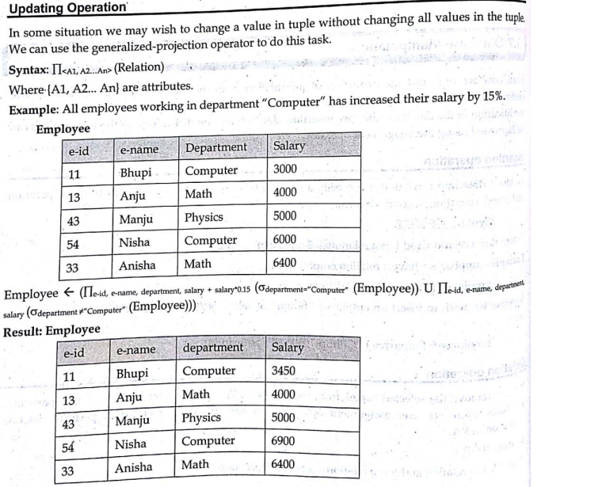

Slide 34
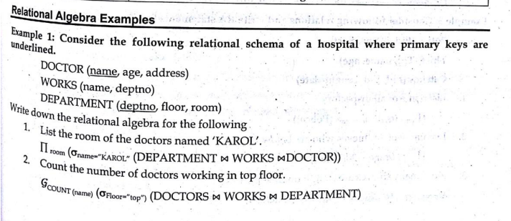
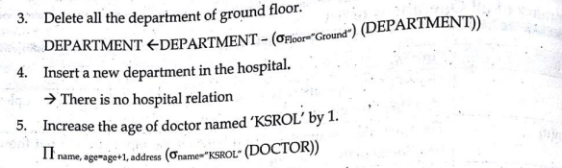

Slide 35
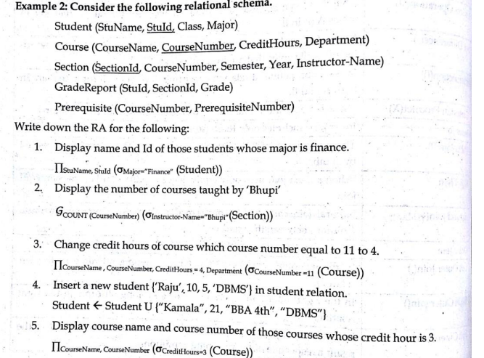

Slide 36
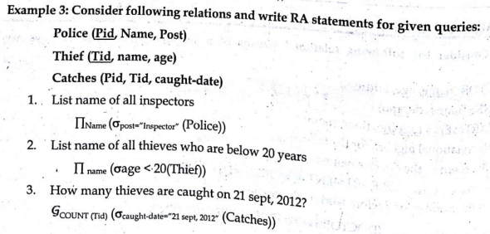
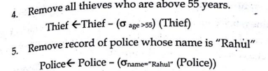

Slide 37
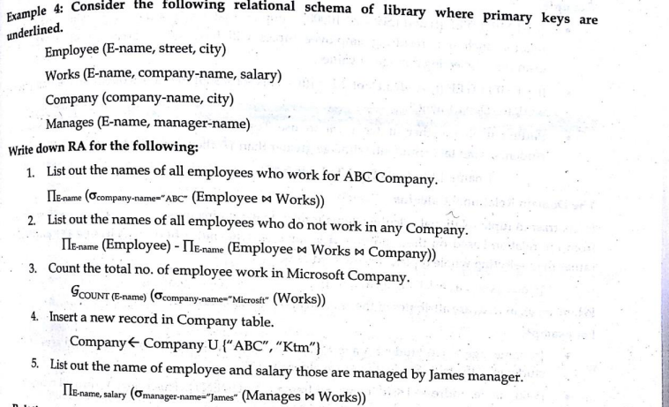

Slide 38
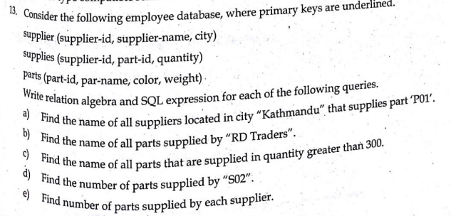

Slide 39
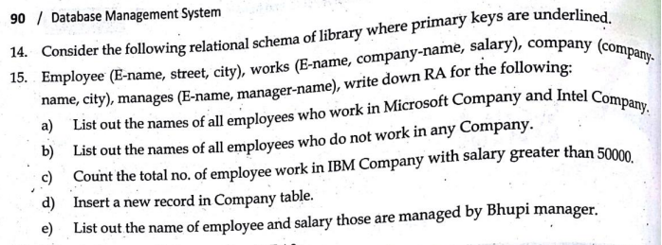

Slide 40
Relational Calculus
Relational calculus is a not procedural query language. It uses mathematical predicate calculus instead of algebra. It provides the description about the query to get the result where as relational algebra gives the method to get the result. It informs the system what to do with the relation but does not inform how to perform it. Relational calculus exists in two forms:
Tuple Relational Calculus(TRC)
Domain Relational Calculus(DRC)
Relational Calculus is mainly based on the well known propositional calculus which is a method of calculating with sentences or declarations. Such sentences or declarations also termed propositions are ones for which a truth value(i.e. “True” or “False”) may be assigned.

Slide 41
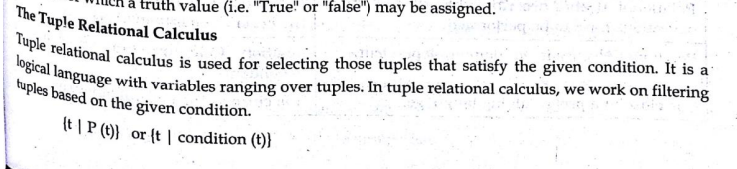
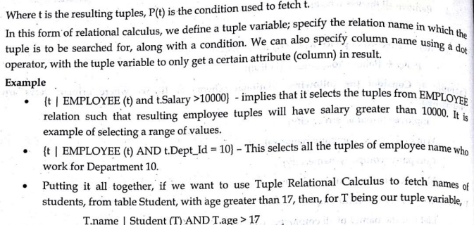
Relational Calculus

Slide 42
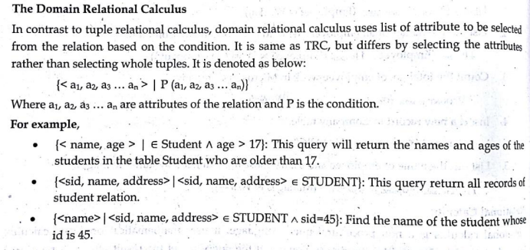
Relational Calculus

Slide 43
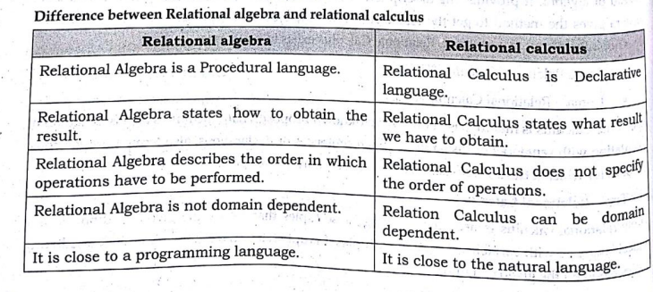
Relational Calculus

